Slide 1
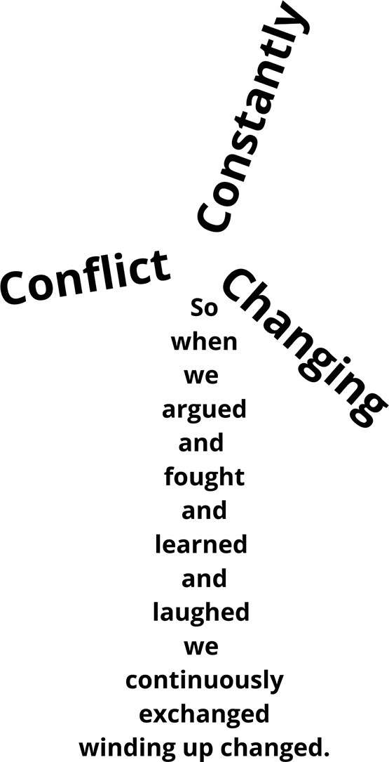
Conflict Powering Change
The value of social conflict in driving institutional change within the Dutch transition to onshore wind energy
By: Annemiek de Looze

Slide 2
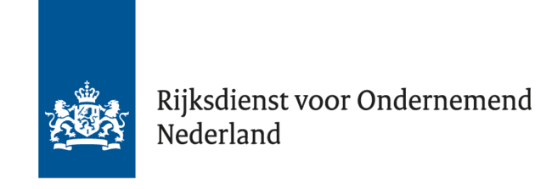







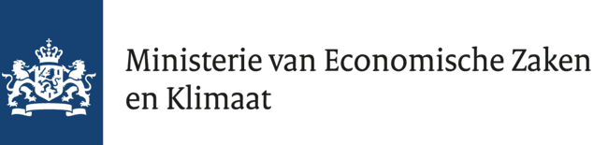



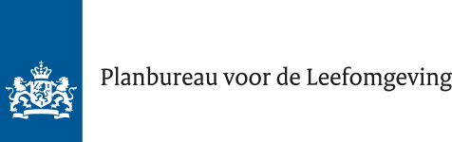

Slide 3


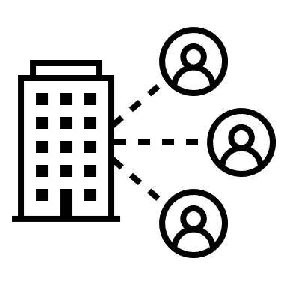
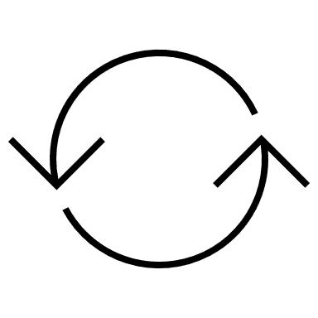
What changes did we observe?
Technological innovation to reduce noise and health effects
Shift in decision-making from national to local/regional level (RES)
Collaborations and partnerships
Increasing inclusion of citizens
Switch from one-way communication to more active participatory models, such as sounding boards, financial participation
informal
formal

Slide 4


Read more:
(de Looze & Cuppen, 2023)
Discover our project: www.justetrans.nl
Get in touch:
a.m.m.de.looze@fgga.leidenuniv.nl

