Slide 1
Sensor Application For The Fermolyzer
To Calculate Ammonium Ion Concentration by Measuring Ammonia Gas, pH, & Temperature
Rachel Carson Graduation Prize 2024 Presentation
By Claudio Cavalieri

Slide 2
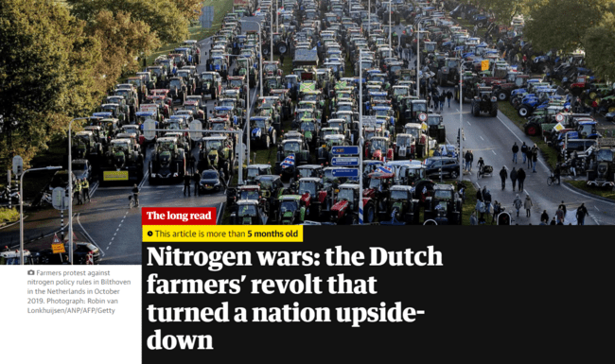
Prelude
Current Situation
(A)

Slide 3
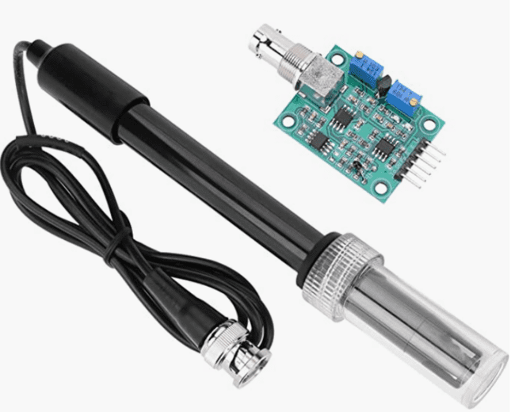
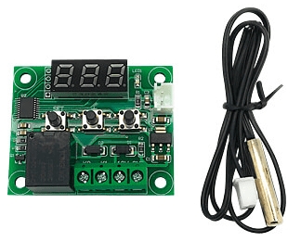
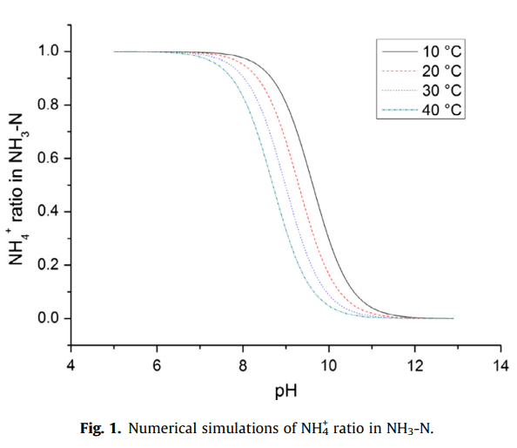
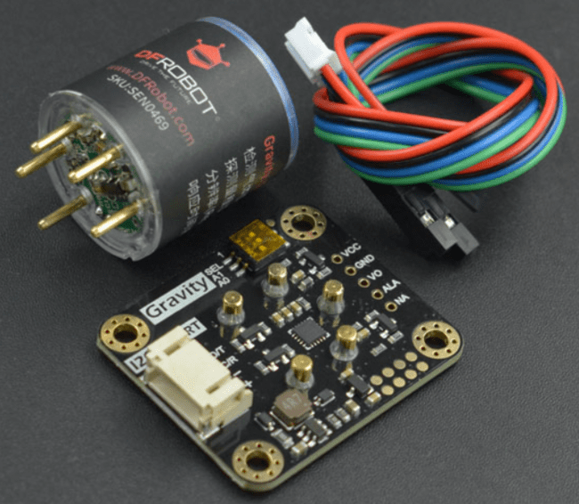
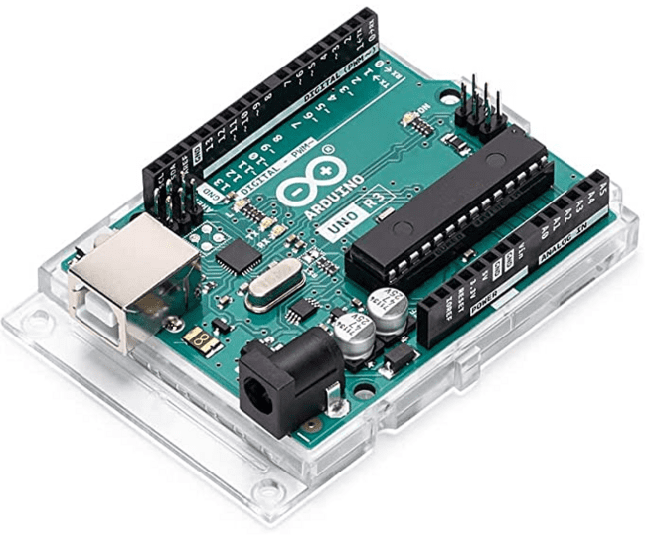
Analysis
The Fermolyzer & Measuring Ammonium Ions
Problem Definition: “How can a sensor application accurately estimate the amount of ammonium present in the Fermolyzer?”
(C)
(D)
(B)
(E)
(F)

Slide 4
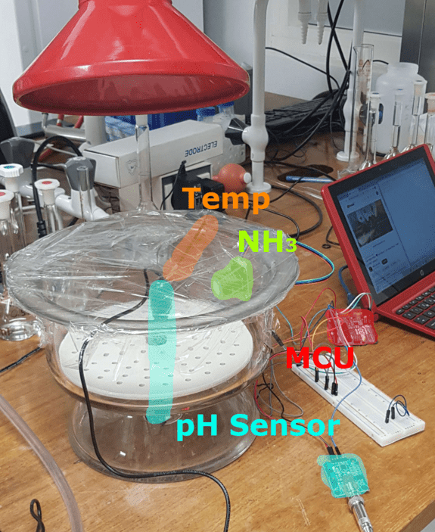
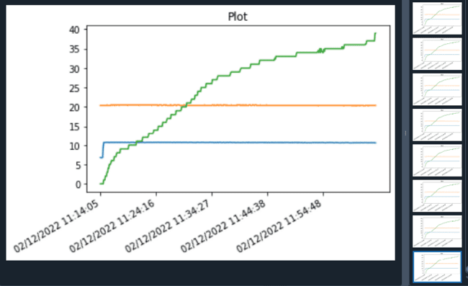
Implementation
Code & Procedure (using Ammonium Hydroxide)
(H)
(G)

Slide 5
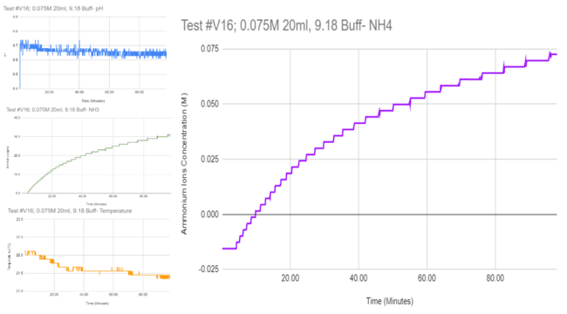
Equation
Step by step - NH₃ to NH₄⁺ || NH₃ v pH to NH₄⁺ || NH₃ v pH v ml to NH₄⁺
NH₃ v pH v ml v Temp to NH₄⁺
(I)
(J)

Slide 6
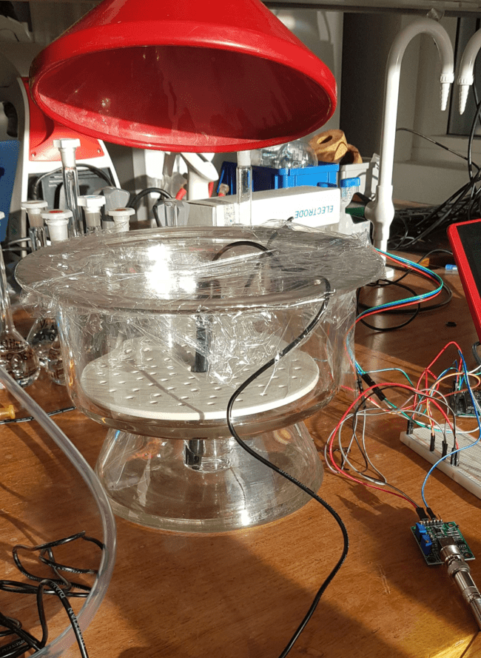
Conclusion
Is it possible to measure NH₄⁺ this way? - Yes!
Things achieved:
Selection for best suited ammonia sensor for the Fertilizer
Arduino & Python codes work as intended
Different conditions of the substance used
Digestate used in the experiments
Customer requirements fulfilled
Calibrations work as intended
Chemical equation observed
DHF complete
Suggestions for future progress - Do more runs
(K)

Slide 7
Thank You
For Your
Attention!
Sources & Appendices on following slides
Defence of the Thesis
Written by Claudio Cavalieri

Slide 8
Sources
(A) - Article from The Guardian: https://www.theguardian.com/environment/2023/nov/16/nitrogen-wars-the-dutch-farmers-revolt-that-turned-a-nation-upside-down
(B) - Image from: Yizhang W., Yuanfang M., Zhaofeng K., Qionghui L. (January 14th, 2019), “Application of an ammonium ion-selective electrode for the real-time measurement of ammonia nitrogen based on pH and temperature compensation”, Hunan, China, ScienceDirect / Elsevier
(C) - Image from Digital store: https://www.amazon.nl/-/en/dp/B08SW89XKQ/ref=sr_1_6?crid=3C2Q78O3SHM7V&keywords= pH-sensor&qid=1668438507&sprefix=ph%2Caps%2C1588&sr=8-6
(D) - Image from Digital store: https://www.reichelt.nl/nl/nl/ontwikkelaarsborden-thermostaat-12-v-digitaal-w1209 -debo-xh-w1209-t-p223621.html?PROVID=2809&gclid=CjwKCAjwzY2bBhB6EiwAPpUpZp3CU3YLLgFrWng0OhJa25dJsxh3XTuXKbxxPyQct6kZkDO7Osgy2xoCcZIQAvD_BwE
(E) - Image from Digital store: https://www.dfrobot.com/product-2513.html
(F) - Image from Digital store: https://www.amazon.de/-/en/A000066-Arduino-Accessory-Parent/dp/B008GRTSV6/ref=sr _1_3?keywords=arduino+uno&qid=1664530963&qu=eyJxc2MiOiI0LjQ1IiwicXNhIjoiMy40NyIsInFzcCI6IjMuMjQifQ%3D%3D&sr=8-3
(G) - Image from the thesis, “Photo of the system while running”
(H) - Image from the thesis, “Python printed results”
(I) - Equation derived from results
(J) - All graphs from the Validation part of the thesis
(K) - Cover Image of the thesis

Slide 9
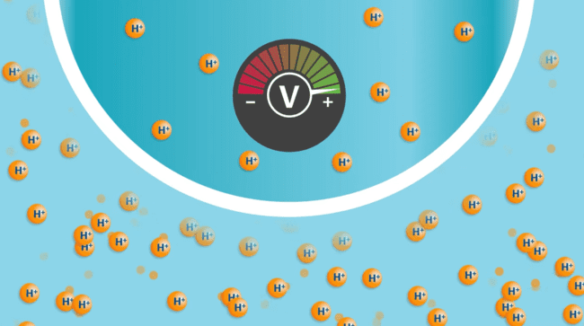
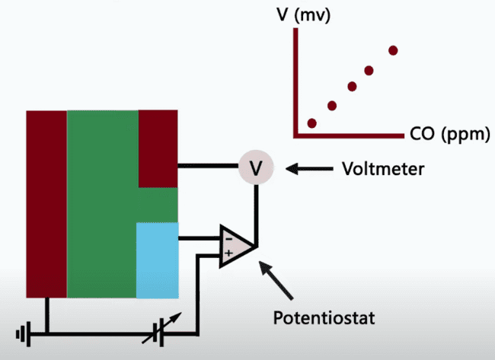
Appendix: How do the sensors work
Temperature - measures the amount of heat present by detecting changes in electrical resistance
pH - measures the concentration of H ions in a solution by detecting changes in electrical potential
Ammonia - measures the concentration of ammonia gas in the air by using a small sensing element that changes its electrical resistance in response to the presence of ammonia
(A)
(B)

Slide 10

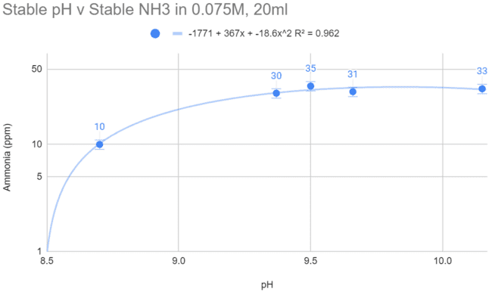

Appendix: Further explanation of the equation
(D)
(E)
(C)
(F)

Slide 11
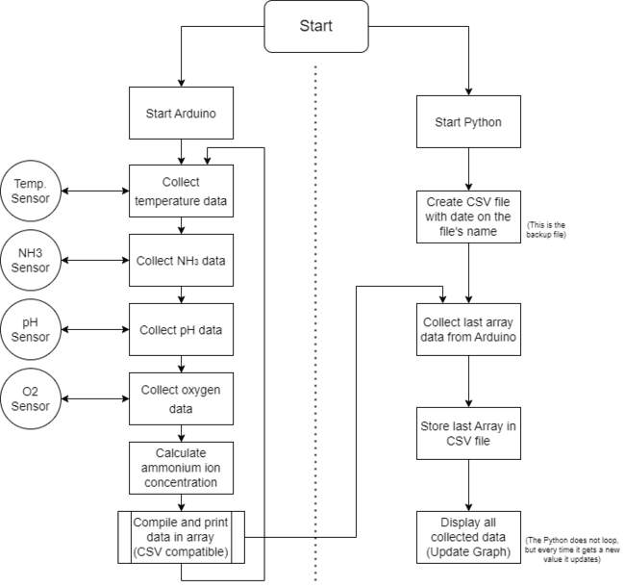
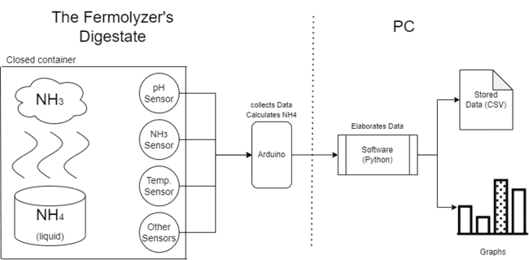
Appendix: Ensemble
(G)
(H)

Slide 12
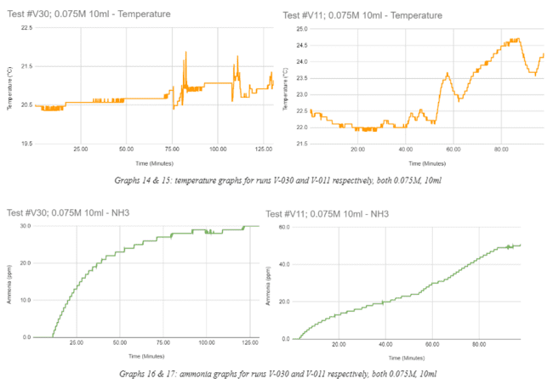
Appendix: Temperature
(3)
(I)

Slide 13
Sources For Appendix
(A) - From YouTube : Rosemount “How pH Sensors Work” https://youtu.be/65r7pJpNT34
(B) - From YouTube : DFRobot “How An Electrochemical CO Sensor Works” https://youtu.be/4cCtoA8dAjg
(C.) - Image from the thesis, “Graphs 26 & 27: pH v ammonia, left for 0.075M, right for 0.025M”
(D) to (F) - Equations derived from results
(G) - Image from the thesis, “Preliminary Design - Conceptual Overview”
(H) - Image from the thesis, “Flowchart of sensor application, both Arduino and Python”
(I) - Images from the thesis in page 30

