Slide 1
RACHEL CARSON THESIS AWARD 2024
AND WHY DO YOU CARE?
THE EUROPEAN UNION’S MOTIVATIONS TOWARDS CLIMATE MIGRATION AND DISPLACEMENT
Laura Steel Pascual
Supervisors: Dr Antonella Maiello, Dr Rutger Hoekstra

Slide 2
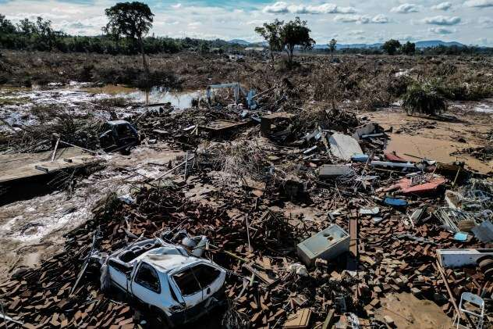
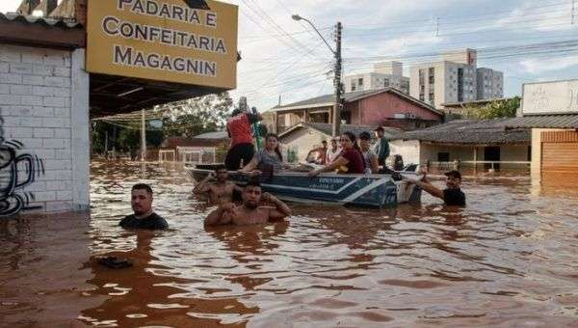
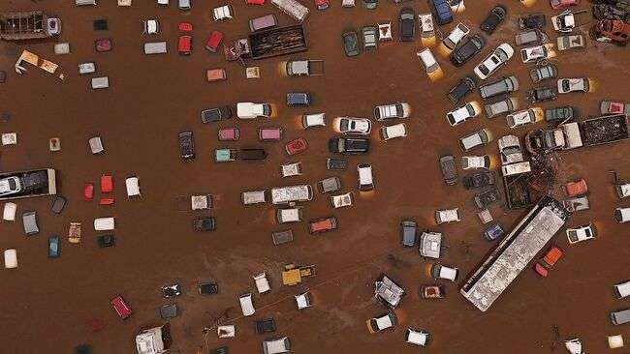
Brazil, floods May 2024

Slide 3
METHODOLOGY
Discursive institutionalism
3 streams of data
European Commission Working
Officials
Loss and Damage Fund
EMN Conference
Interviews
Speeches
Documental materials
Abductive research design

Slide 4
MOTIVATIONS: THE HUMANITARIAN DEFENCE
Highly interlinked
HUMANITARIAN
REPUTATIONAL
Basics: Climate migration as an inevitable problem, creating or exacerbating vulnerabilities. Normative understandings and sentiments of concern for the displaced.
The displaced: In need of assistance, victims, passive.
EU: Human rights advocate.
Language expresses the plight of the displaced.
Climate Hazards hurt the vulnerable, mostly in third countries.
Basics: Climate migration as a challenge. Pragmatic, resolution-oriented understandings and sentiments of concern for how the EU will take a leading role.
The displaced: The challenge, a signalling device, to be overcome procedurally.
EU: At the forefront, proactive (even when reactive), responsible, responsive, authoritative.
Climate Hazards require management and leadership, mostly in third countries.

Slide 5
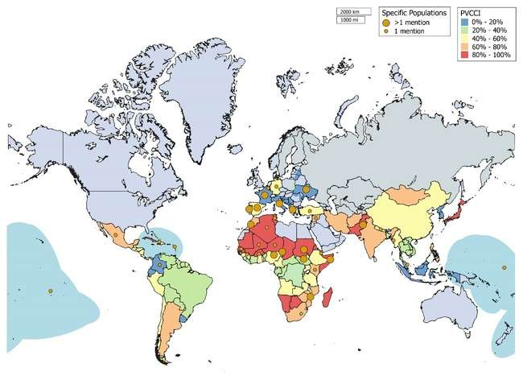
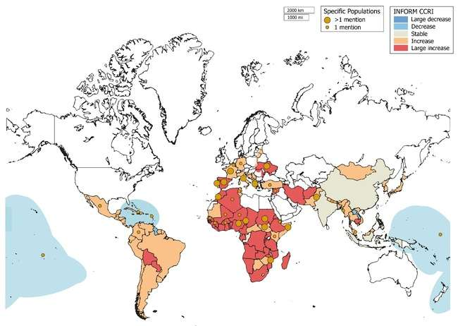
CLIMATE HAZARDS AND PHYSICAL VULNERABILITY: PERCEIVED OVERALL EXPOSURE
Only physical vulnerability
Considering socioeconomic factors
Mentions are added to the National PVCCI map adapted from “PVCCI” by M. Closset, S. Feindouno, P. Guillaumont and C. Simonet, 2018. Copyright 2022 by FERDI.
Mentions are added to the change in natural hazard scores for pessimistic scenario (RCP 8.5 + SSP3) (2050-baseline) map adapted from “INFORM Climate Change Tool” by the EC Disaster Risk Management Knowledge Centre, 2022. In the public domain.

Slide 6
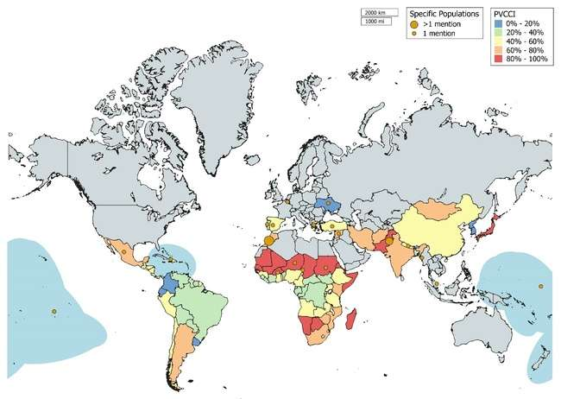
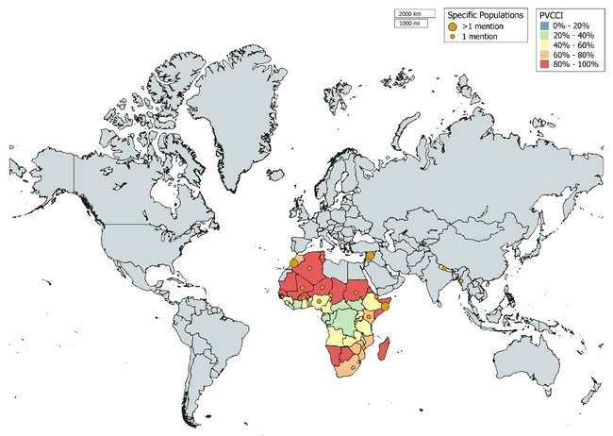
CLIMATE HAZARDS AND PHYSICAL VULNERABILITY: LINKED TO CONCERNS
Humanitarian concerns
Instability concerns
Mentions are added to the National PVCCI map adapted from “PVCCI” by M. Closset, S. Feindouno, P. Guillaumont and C. Simonet, 2018. Copyright 2022 by FERDI.
Mentions are added to the National PVCCI map adapted from “PVCCI” by M. Closset, S. Feindouno, P. Guillaumont and C. Simonet, 2018. Copyright 2022 by FERDI.

Slide 7
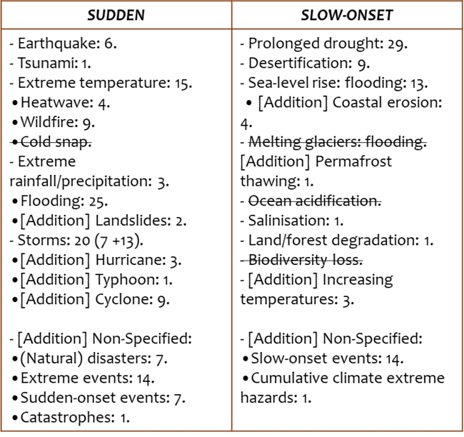
CLIMATE HAZARDS AND PHYSICAL VULNERABILITY: SUDDEN VS SLOW-ONSET

Slide 8
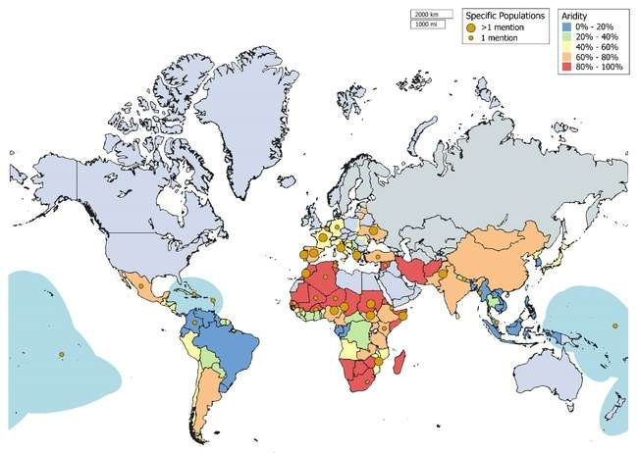
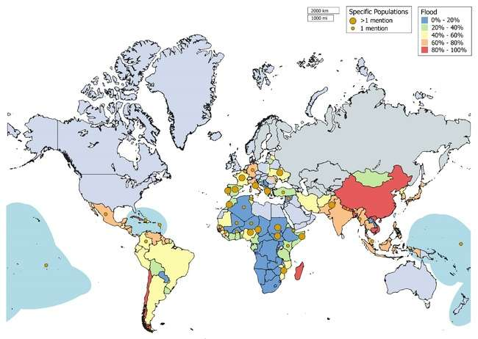
CLIMATE HAZARDS AND PHYSICAL VULNERABILITY: ARIDITY AND FLOODING
Aridity
Flooding
Mentions are added to the National Aridity PVCCI map adapted from “PVCCI” by M. Closset, S. Feindouno, P. Guillaumont and C. Simonet, 2018. Copyright 2022 by FERDI.
Mentions are added to the National Flooding PVCCI map adapted from “PVCCI” by M. Closset, S. Feindouno, P. Guillaumont and C. Simonet, 2018. Copyright 2022 by FERDI.

Slide 9
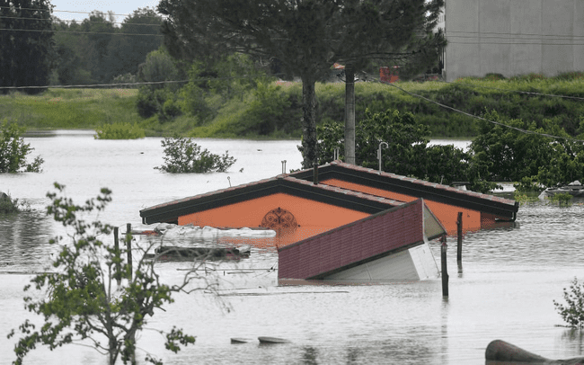
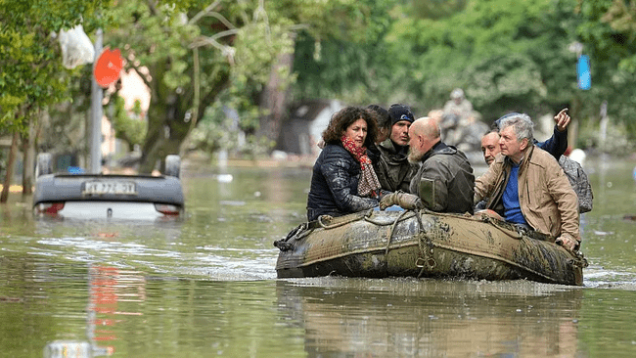
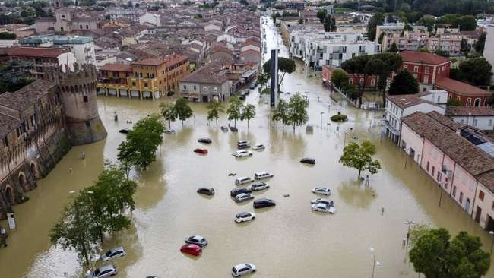
Italy, floods May 2023

Slide 10
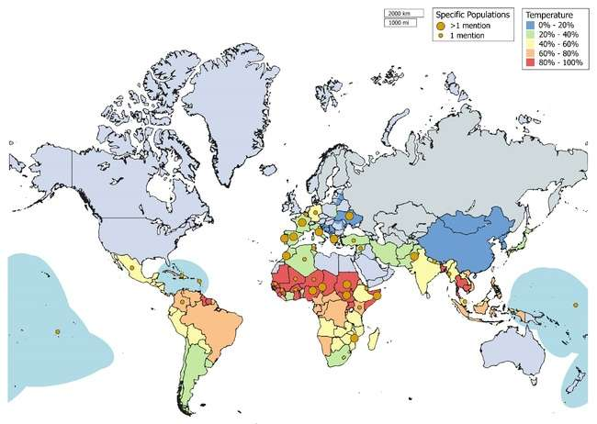
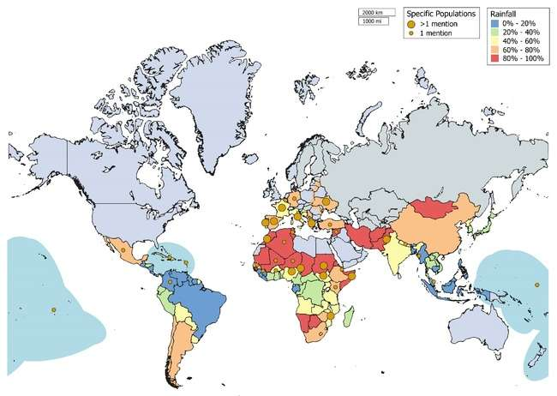
CLIMATE HAZARDS AND PHYSICAL VULNERABILITY: EXTRA
Temperature
Rainfall
Mentions are added to the National Temperature PVCCI map adapted from “PVCCI” by M. Closset, S. Feindouno, P. Guillaumont and C. Simonet, 2018. Copyright 2022 by FERDI.
Mentions are added to the National Rainfall PVCCI map adapted from “PVCCI” by M. Closset, S. Feindouno, P. Guillaumont and C. Simonet, 2018. Copyright 2022 by FERDI.

Slide 11
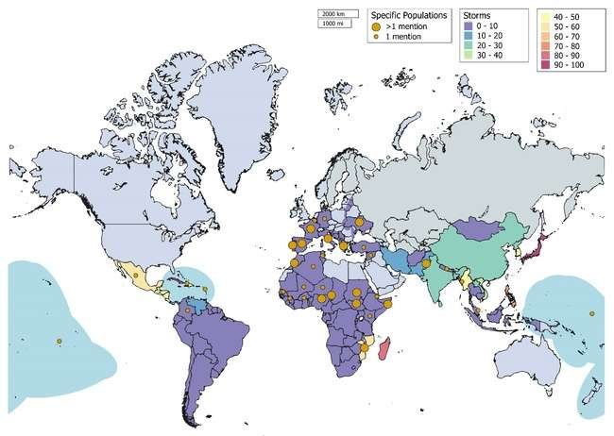
CLIMATE HAZARDS AND PHYSICAL VULNERABILITY: EXTRA
Storms
Mentions are added to the National Storms PVCCI map adapted from “PVCCI” by M. Closset, S. Feindouno, P. Guillaumont and C. Simonet, 2018. Copyright 2022 by FERDI.

