Slide 1
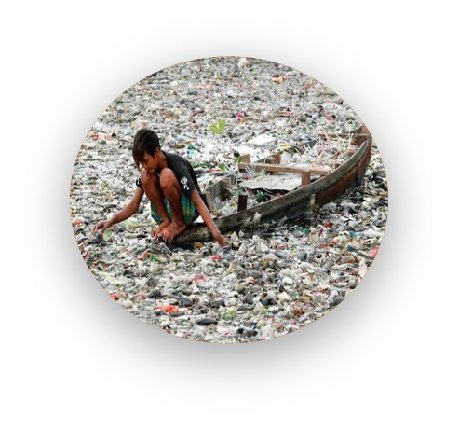
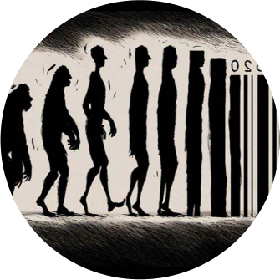
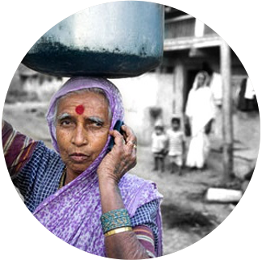
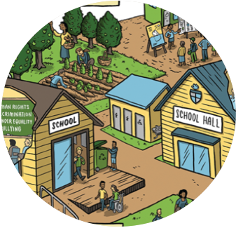

SustainaBul or SustainaBull? From cosmetic reform to deep change Groene Peper, Den Haag, May 23rd 2025 Arjen Wals Wageningen University/UNESCO Chair

Slide 2


1972…

Slide 3
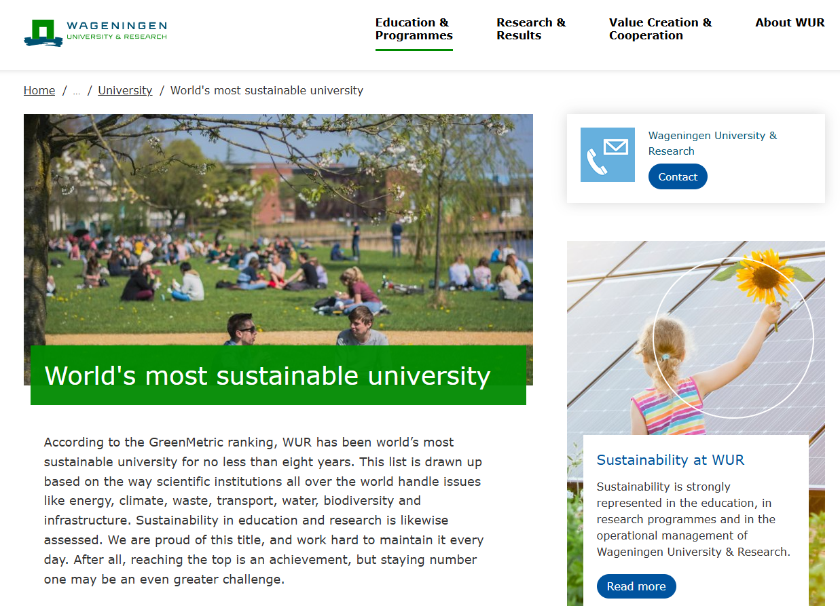

Slide 4
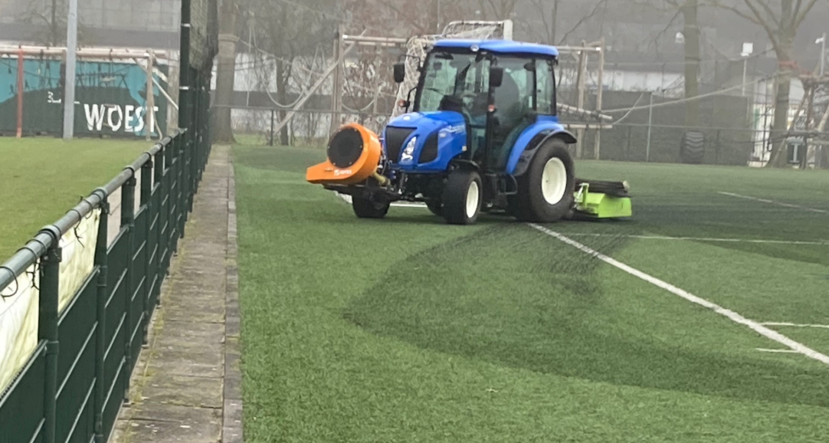
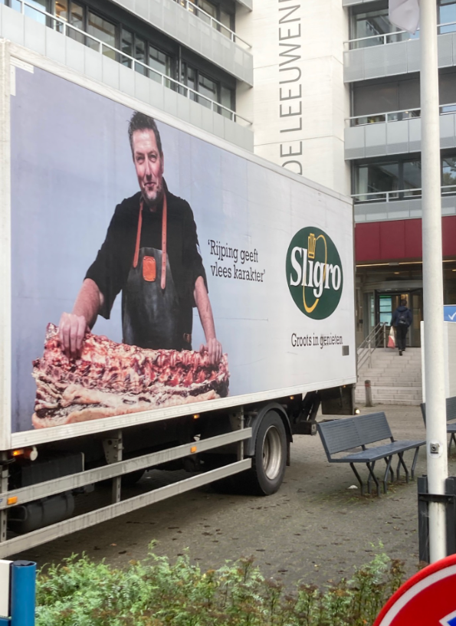
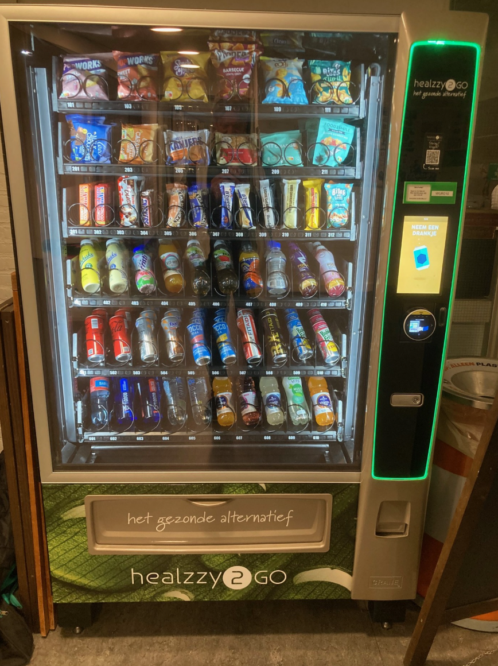
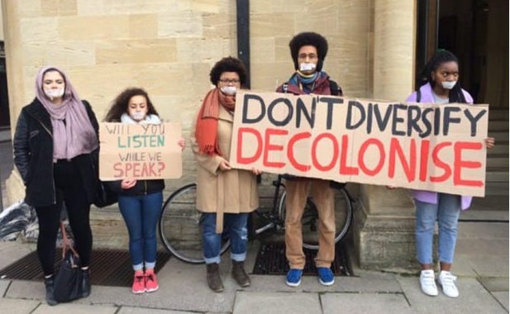

Slide 5
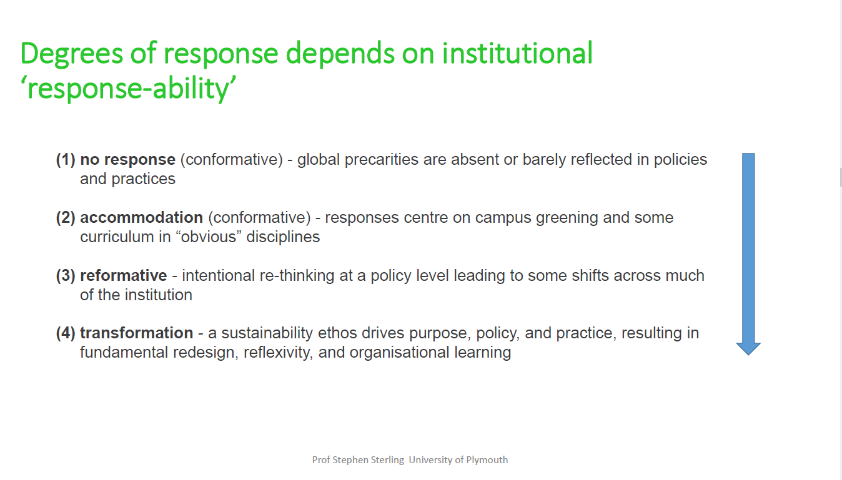
From cosmetic reform to deep change
Denial
Bolt-on
Build-in
Whole system re-design
Based on Sterling, 2004
Notes:
Han sier at universitetenes respons på prekære utfordringer i samfunnet avhenger av det han kaller institusjonens «response- ability», hvor: ingen respons;

Slide 6

Whole University/Institution Approach to Sustainability
(Based on Mathie & Wals, 2022)

Slide 7
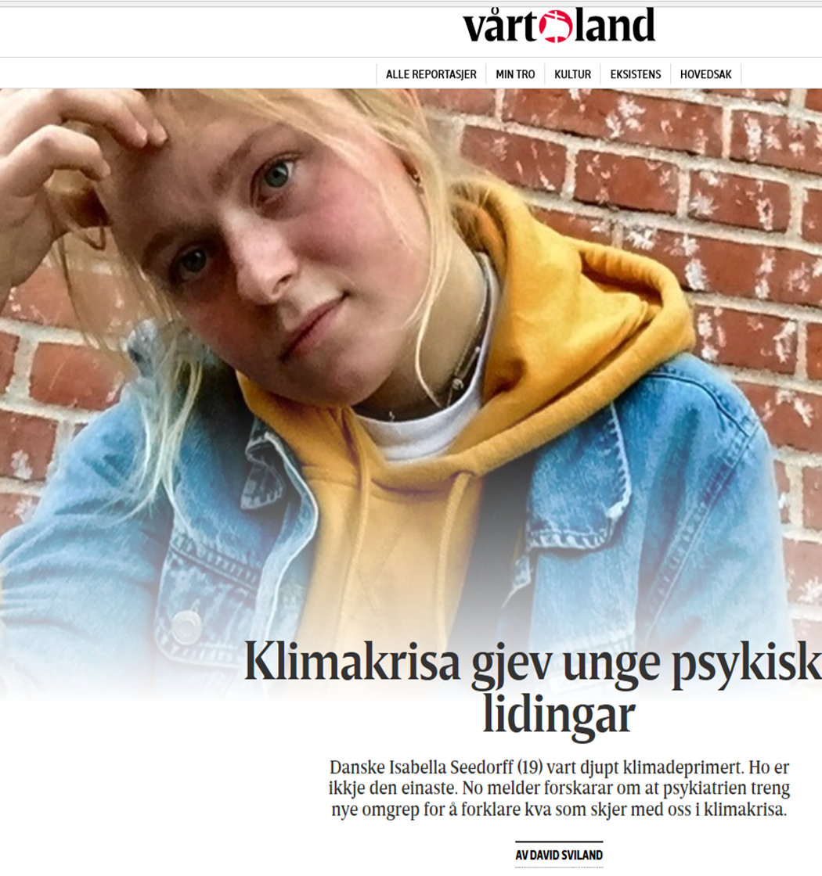

Anxiety about the future can lead to despair, depression and apathy

Slide 8


Slide 9
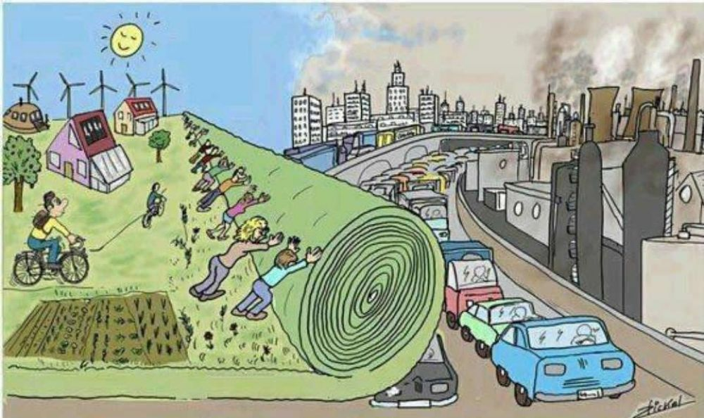

Slide 10
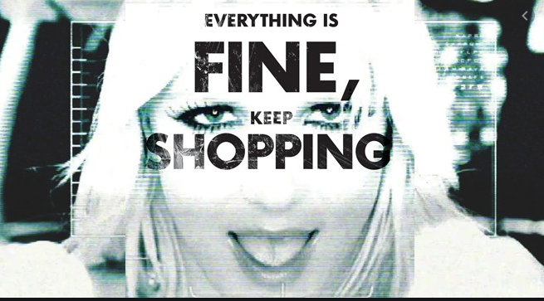
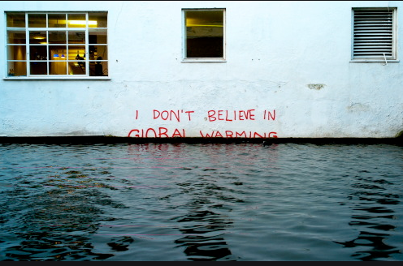
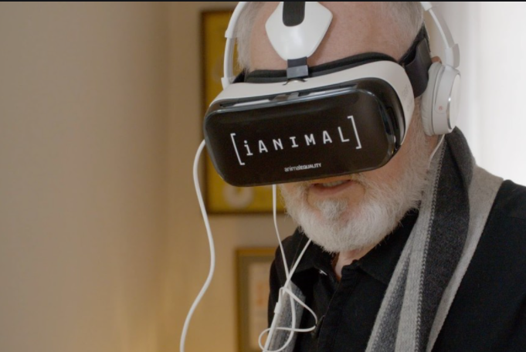
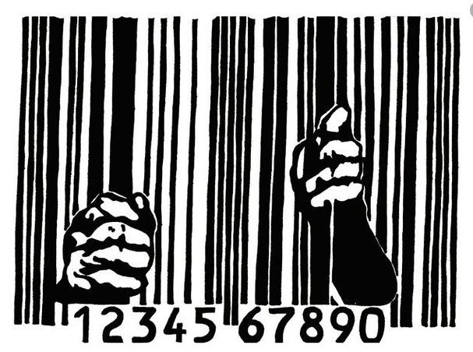
Resistance Pedagogy – going against the grain
Asking difficult questions
Questioning the normal – mapping and interrogating habitualized conventions
Eliciting underlying principles, values and mechanisms
Piquing behind the curtains (agro-industry, sweatshops, fake-news, nudging)
Space for alternatives, doing things differently and doing different things

Slide 11

From the rational to the relational…
Source: creative commons

Slide 12
From cosmetic reform to deep change and back?
?
Denial
Bolt-on
Build-in
Whole system re-design
Based on Sterling, 2004
Notes:
Han sier at universitetenes respons på prekære utfordringer i samfunnet avhenger av det han kaller institusjonens «response- ability», hvor: ingen respons;

Slide 13
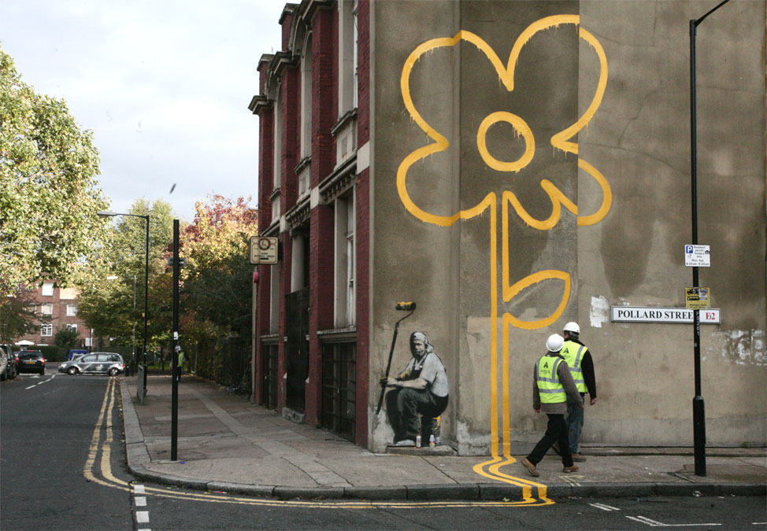
Dare to transgress!
Email: arjen.wals@wur.nl
Blog: www.transformativelearning.nl
Source: Banksy
Notes:
22/05/2025
13

